Slide 1
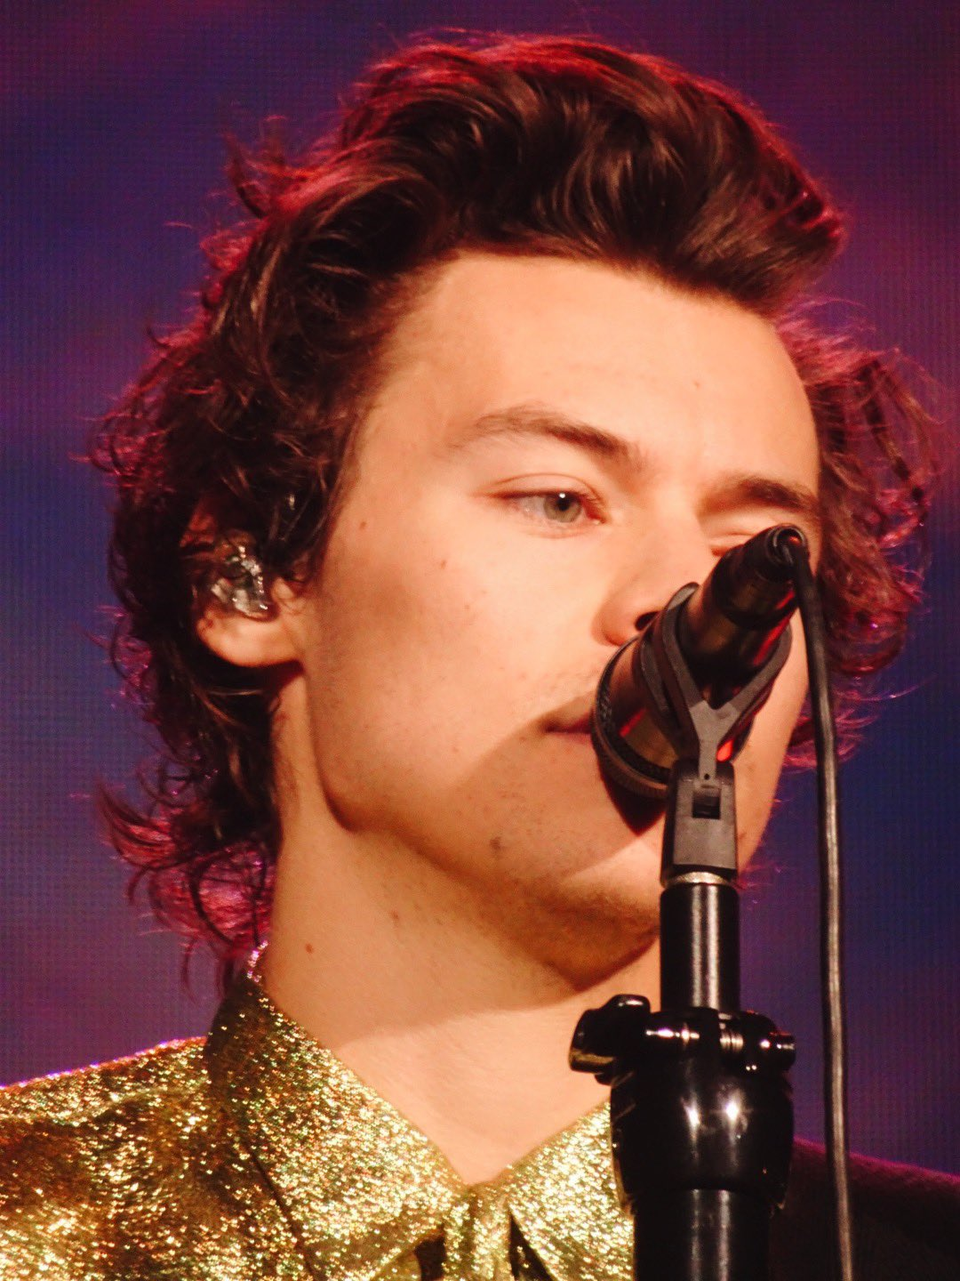
Harry Styles
By Loz

Slide 2
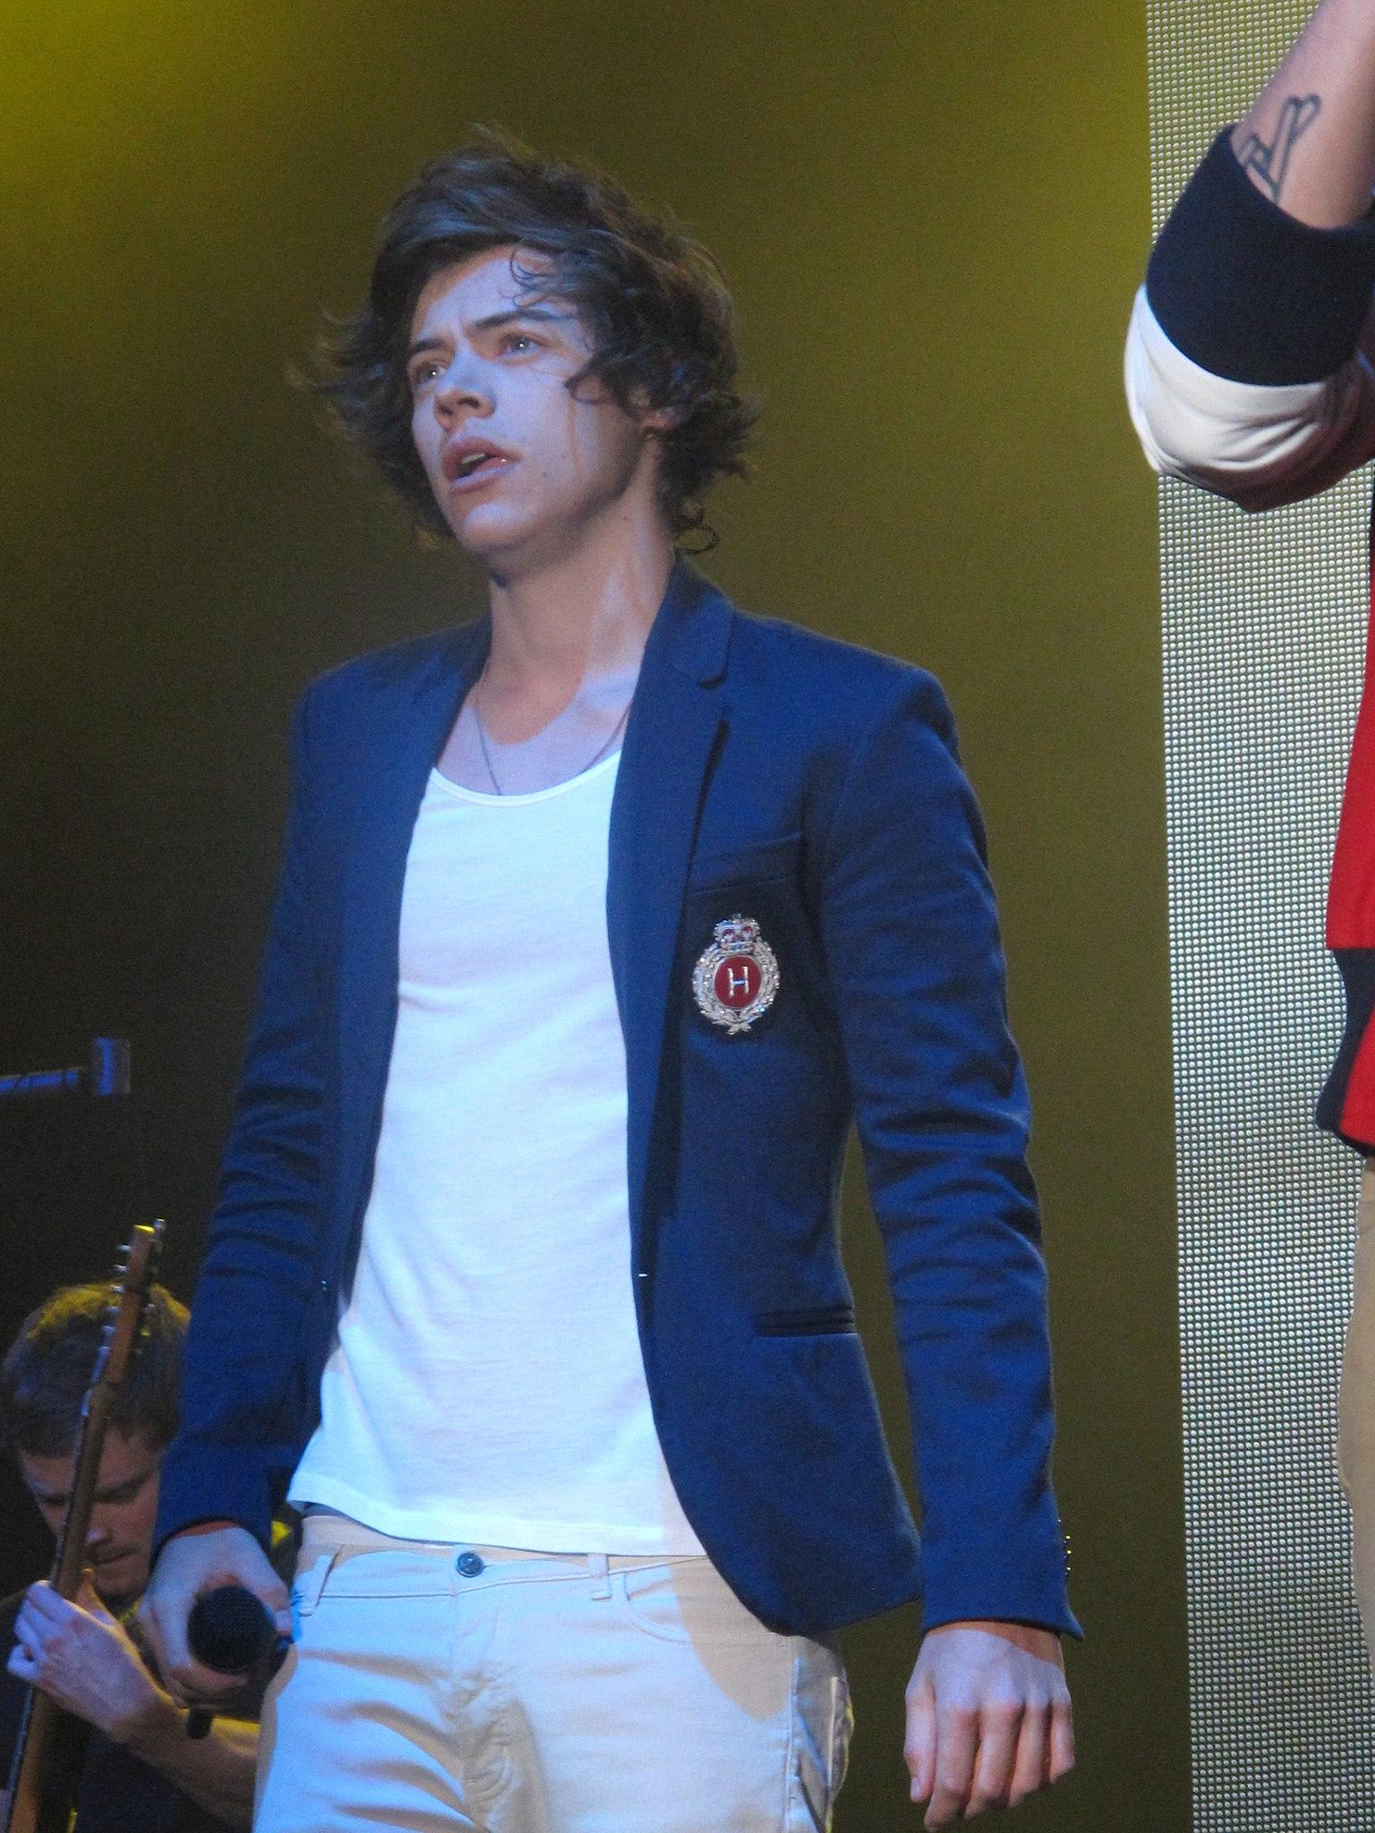
Facts about Harry
His real name is Harry Edward Styles
He was born February 1, 1994 in Redditch Worcestershire
I can tell you one thing he is not dead
Harry had a great childhood being supported by his parents and getting lots of love
His parents divorced when Harry was 7 years old
Gained two step siblings as his mom remarried twice
He sang covers on the karaoke machine
Net Worth 120 Million$$

Slide 3
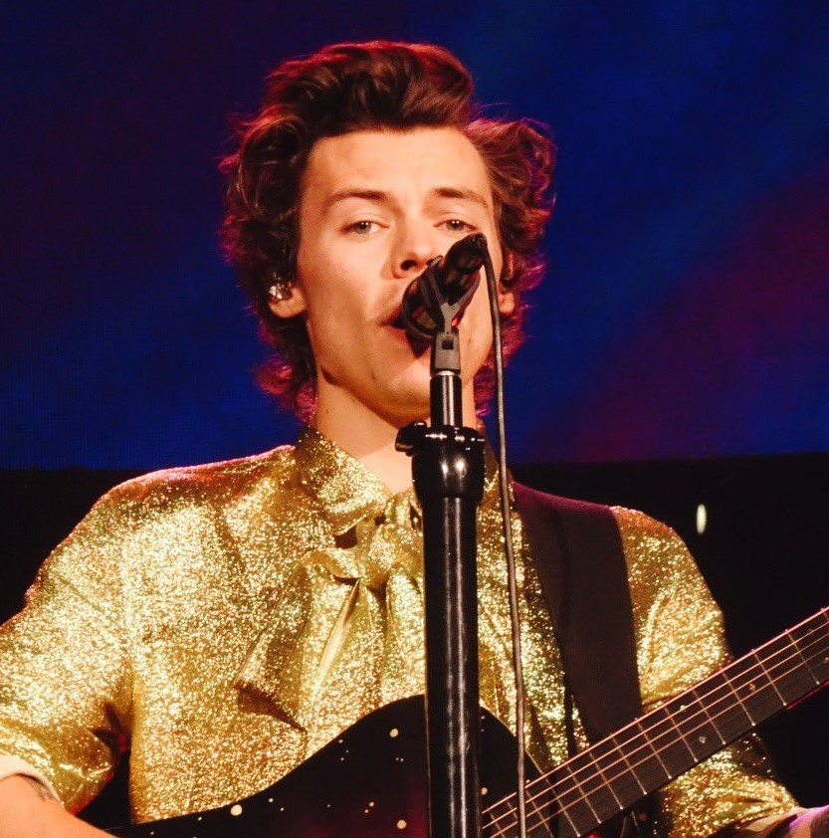
When did he start his singing and acting career?
Styles made a start to his career in music at Holmes Chapel Comprehensive School, where he was the lead singer of the band White Eskimo.
In 2010, Styles mother encouraged and pushed him to try out for The X Factor the tv show
In The X Factor Harry performed "Isn't She Lovely."
After that he kept trying acting and singing
He was 16 when he started

Slide 4
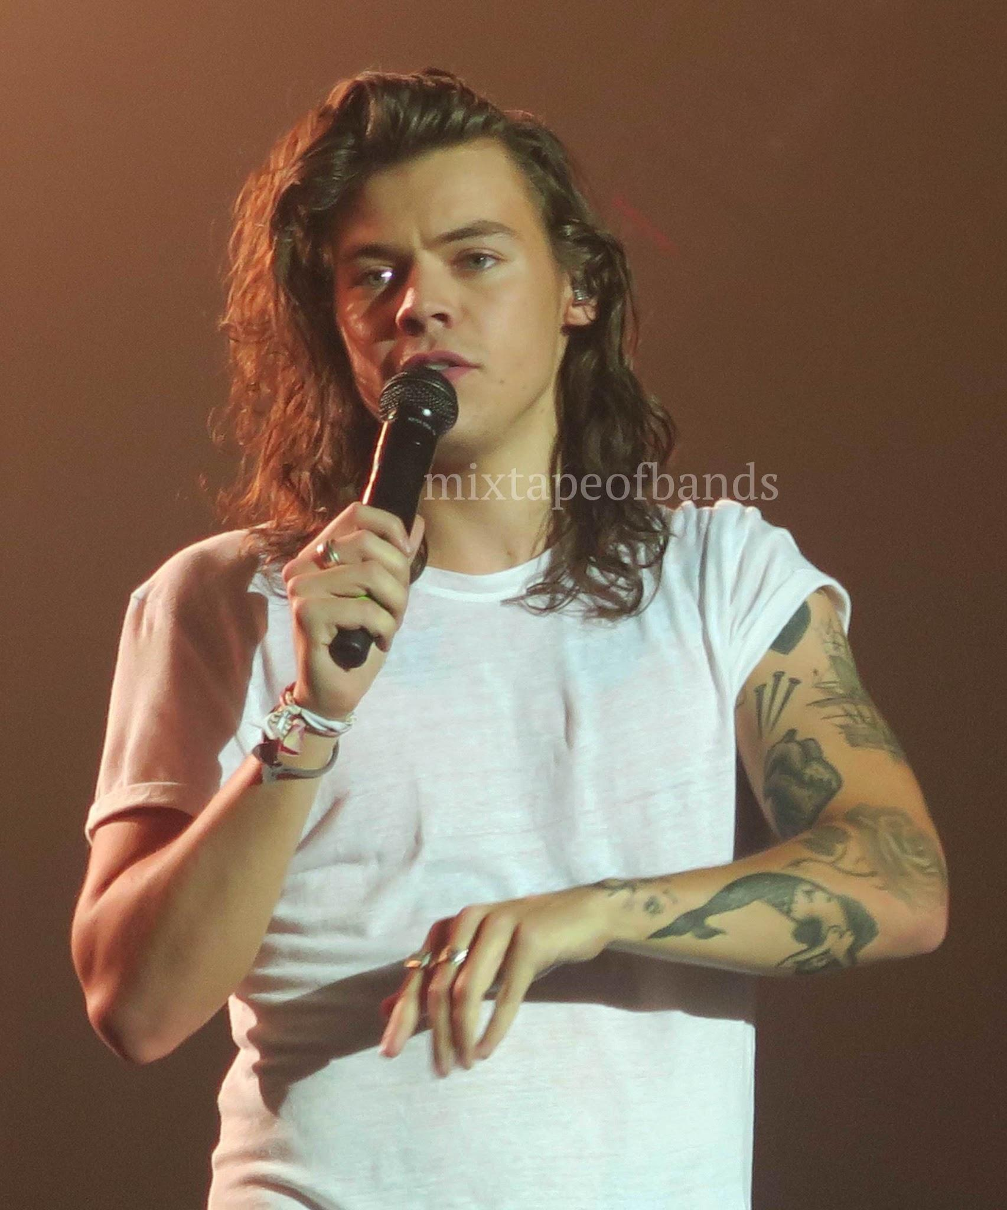
Where is Harry Styles today or is he still active?
He is still active
Styles is currently on a successful world tour. He also starred in a music video “As It Was” released in 2022.
Played Thanos’s brother in eternals
His acting career is still working for him
He is currently in Italy right now
He is 29 right now

Slide 5

What are Harry Styles most popular songs?
Watermelon Sugar
Sign of Times
Golden
Falling
Kiwi
She
Cherry
Only Angel
Adore You
Sweet Creature
Here is a song called Watermelon Sugar https://www.youtube.com/watch?v=E07s5ZYygMg

Slide 6
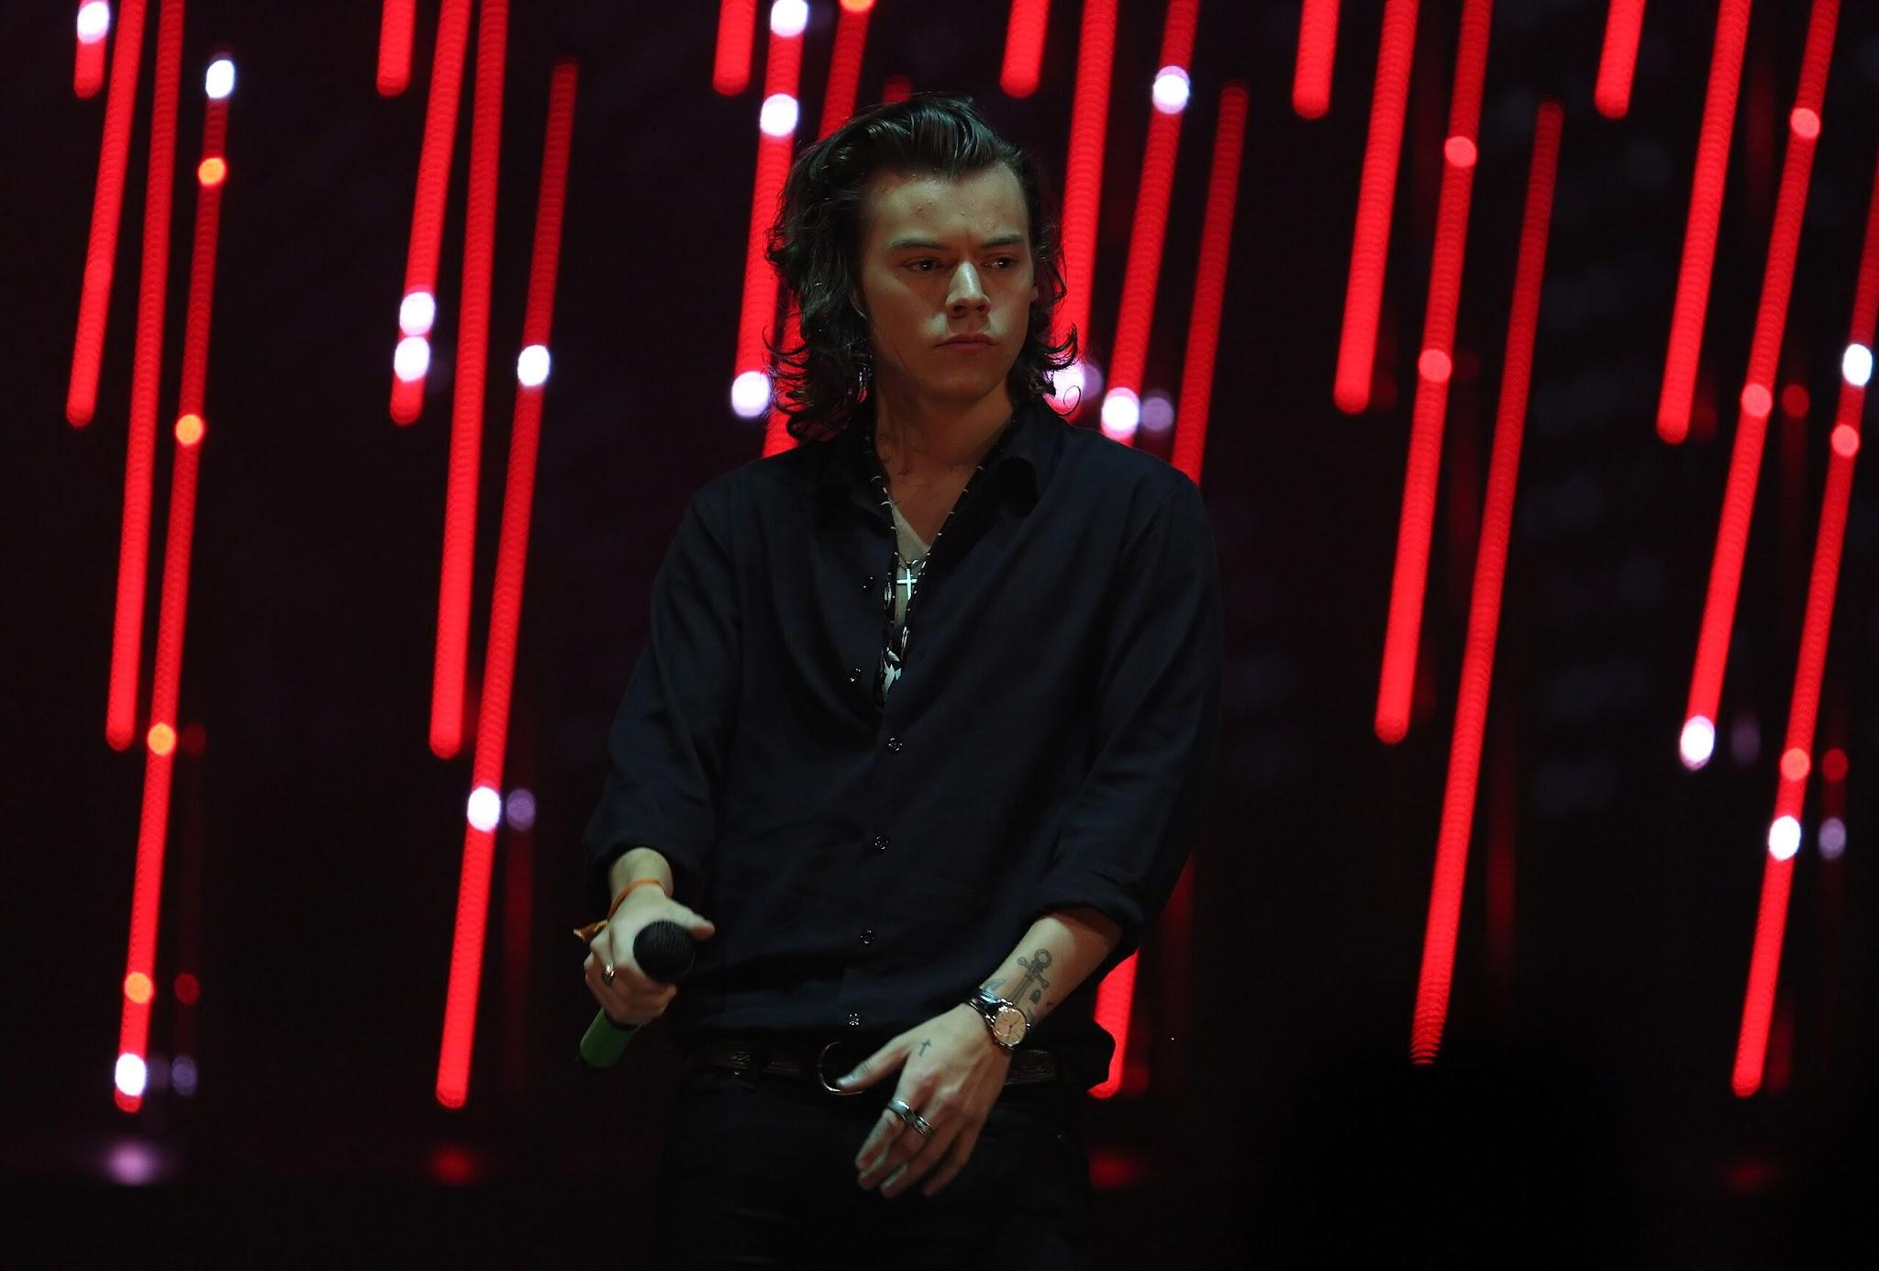
Sources
https://en.wikipedia.org/wiki/Harry_Styles
https://www.thethings.com/what-did-harry-styles-do-before-he-became-famous/#:~:text=The%20career%20path%20he%20would,idea%20and%20become%20a%20singer.
https://www.britannica.com/biography/Harry-Styles
https://coopwb.in/info/where-is-harry-styles-right-now/
https://www.classicrockhistory.com/top-10-harry-styles-songs/
https://www.celebritynetworth.com/richest-celebrities/singers/harry-styles-net-worth/
Leo

